Slide 1


Francine A. Cronin
Associate Vice Chancellor of University Development
April 12, 2016

Slide 2

Themes for Today’s Presentation
  Overarching Goals
  Campaign Update
  Key Deliverables & Campaign Kick-off Preparation
  Preview of Campaign Brand & Identity

Slide 3
Campaign Overarching Goals
  Raise at least $1.5B for key University priorities
  Strengthen reputation of the University so that the whole is greater than the sum of its parts
  Expand and mobilize our alumni and volunteer community
  Institute a broad-based Culture of Philanthropy
    Showcasing the impact of giving
    Recognizing philanthropic leadership
  Establish a lasting University Advancement infrastructure

Slide 4

Campaign Giving
As of: March 31st = $841M

Slide 5
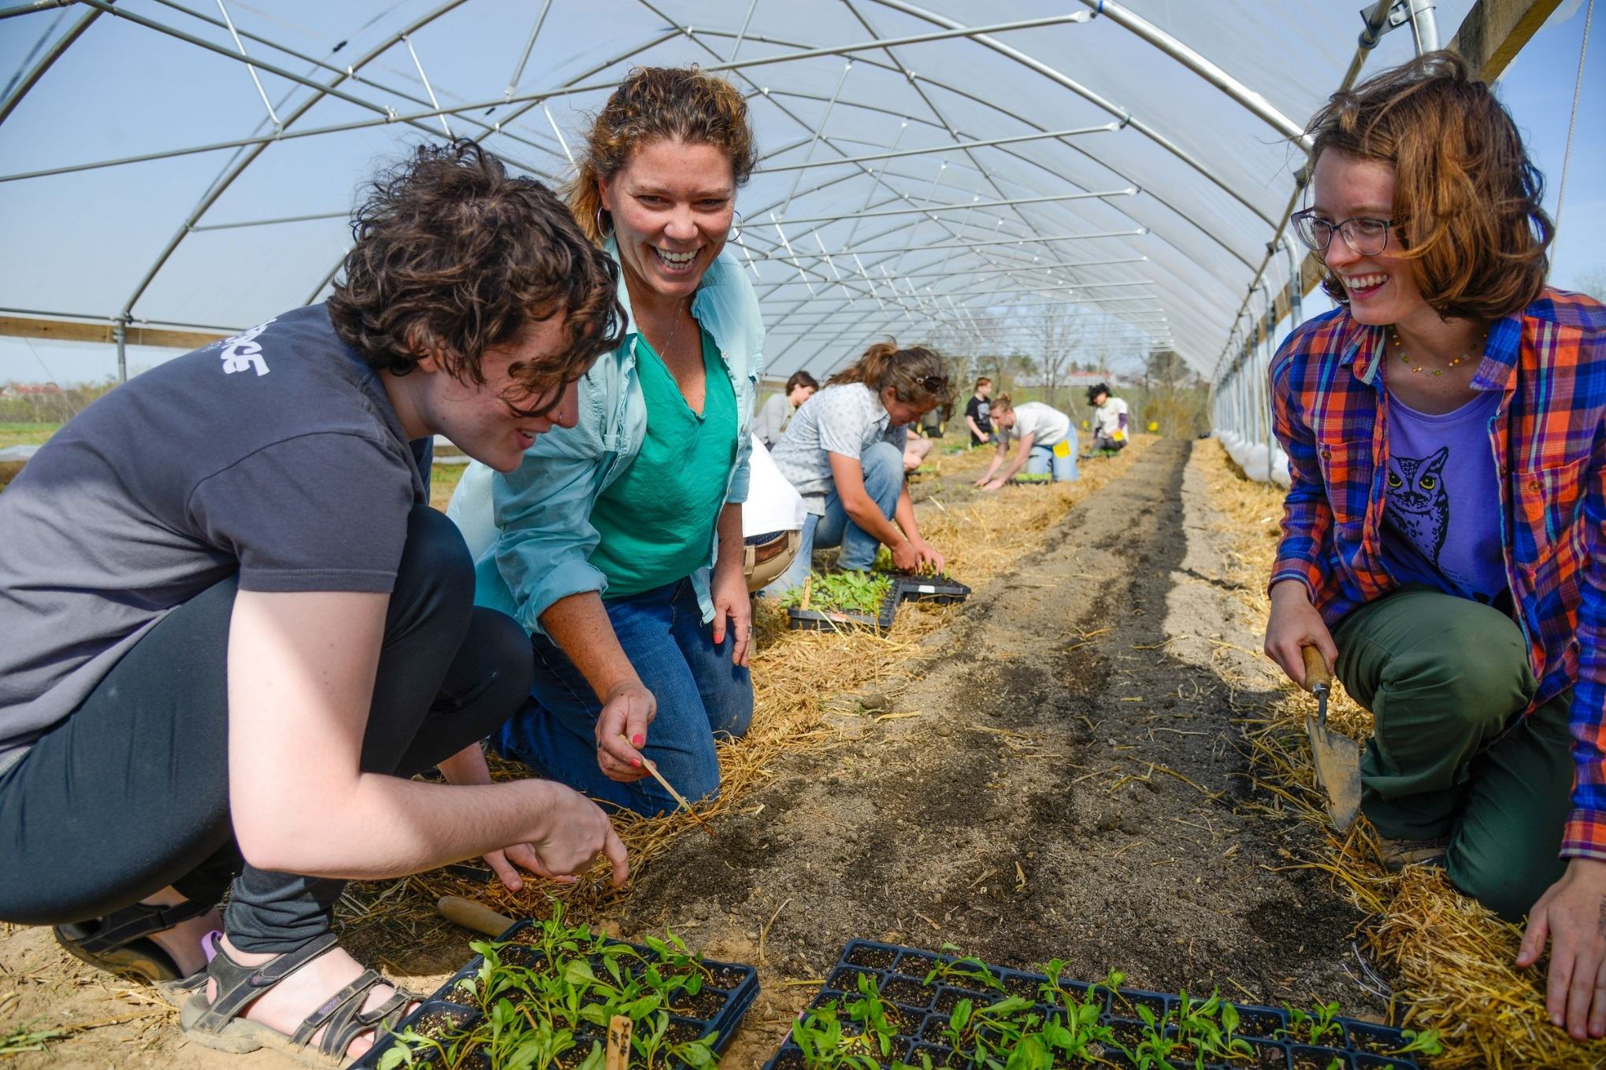
CALS Campaign Giving
As of: March 31st = $175.6M

Slide 7

Total Campaign Commitments
$840.92 Million
Campaign Contributions by Giving Range
As of March 31, 2016

Slide 8
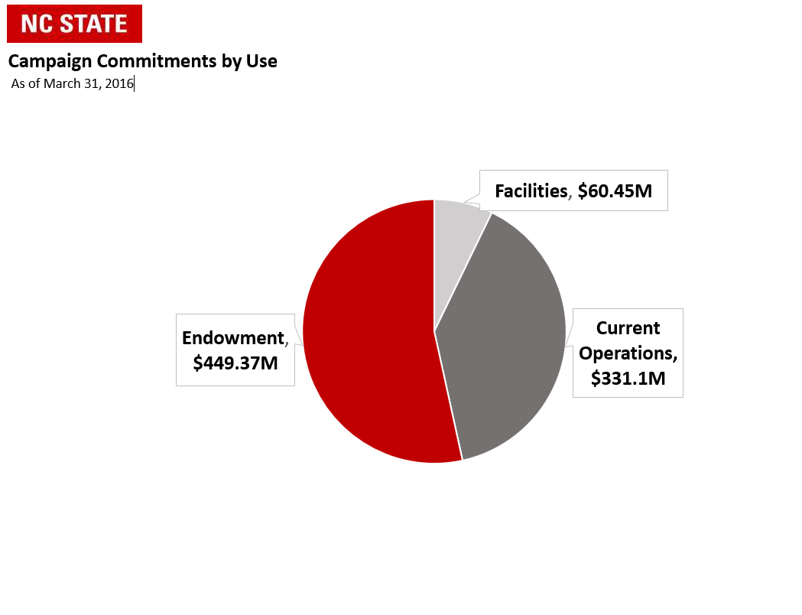
Total Campaign Commitments
$840.92 Million

Slide 9
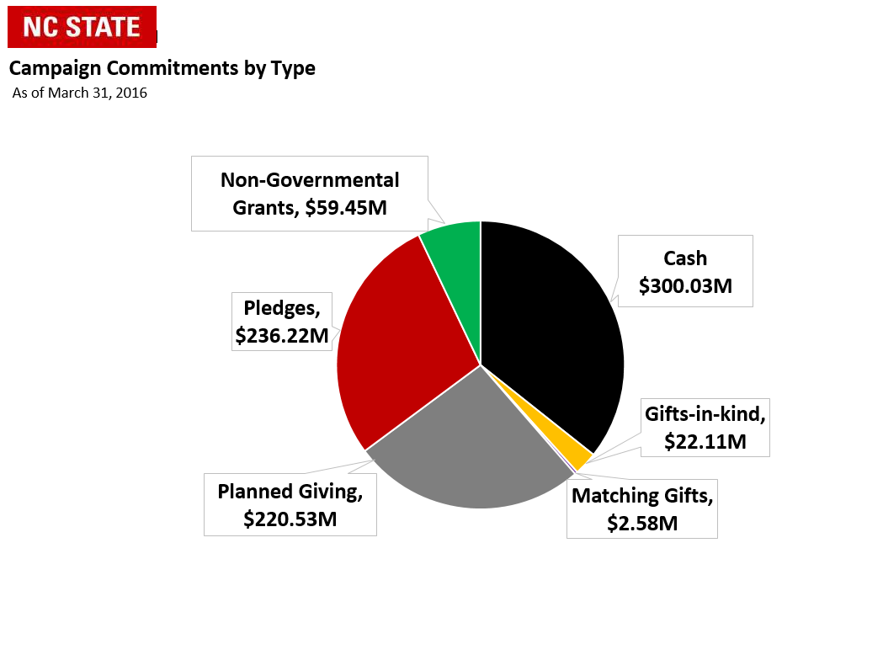
Total Campaign Commitments
$840.92 Million

Slide 10
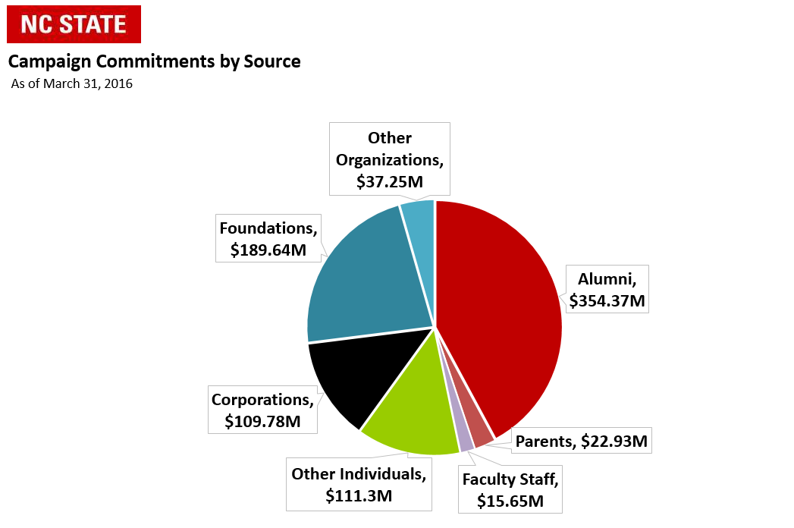
Total Campaign Commitments
$840.92 Million

Slide 11
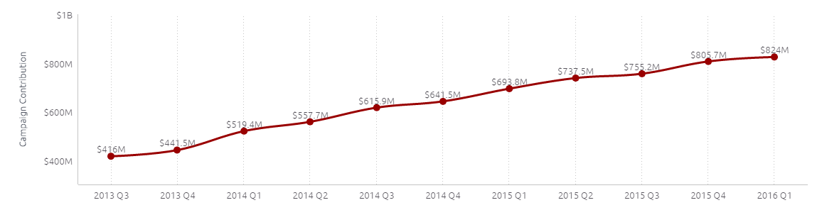
Campaign Progress Timeline
NUCLEUS PHASE
Feb 17, 2016
Sep 30, 2013

Slide 12
10 Key FY16 Campaign Deliverables
  Secure at least 60% of Campaign Goal ($900M)
  Determine Campaign Sub Goals & Featured Objectives
  Finalize & Standardize Campaign Reports
  Recruit Campaign Volunteer Leadership
    Volunteer Leadership Summit—Thursday June 16 – Friday, June 17 at The Umstead
  Plan for October 23-30, 2016 Kick-off Event(s)

Slide 13
10 Key FY16 Campaign Deliverables
  Develop Campaign Branding & Marketing Materials
  Qualify TBD # of Major Gift/Leadership Gift Prospects
  Develop Stewardship Plans & Activities
  Create Internal Campaign Operations Workgroup (C.O.W.)
  Have Fun and Stay Sane!

Slide 15
Campaign Kick-off Week
October 23-30, 2016
  Thursday night, October 27, 2016 – Evening of the Stars. Invitation Only.
  Friday afternoon/evening, October 28, 2016 – Homecoming Parade and Related College/Unit Celebrations.
  Friday night, October 28, 2016 – Campaign Kick-off. Invitation Only.
  Saturday, October 29, 2016 – Football Game vs. Boston College.

Slide 16
Campaign Kick-off Week
October 23-30, 2016
  Foundation Boards
  Scholarship Events
  Faculty Recognitions
  Student Engagement
  Anything that will elevate the celebratory nature of the week and provide additional incentives to be on campus for other exciting events!

Slide 17
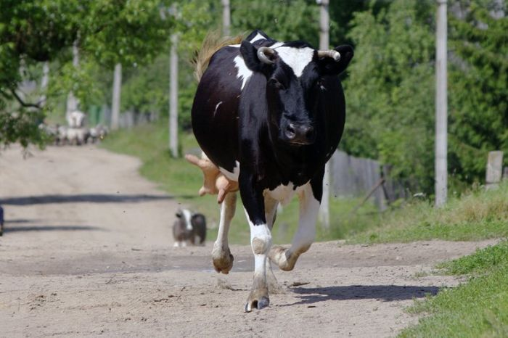
Campaign Operations Workgroup (C.O.W.)

Slide 18
Campaign Operations Workgroup (C.O.W.)
  Communications & Marketing
  Events
  Prospects/Pipeline
  Reports
  Stewardship
  Volunteer Leadership Management

Slide 19
Campaign Operations Workgroup (C.O.W.)
  Critical to Successful Completion of Campaign
  Engage Advancement/Development Staff & Others in Campaign Execution
  Ensure Key Duties are Being Planned For & Managed
  Align Deliverables with All Aspects of Campaign Operations

Slide 20
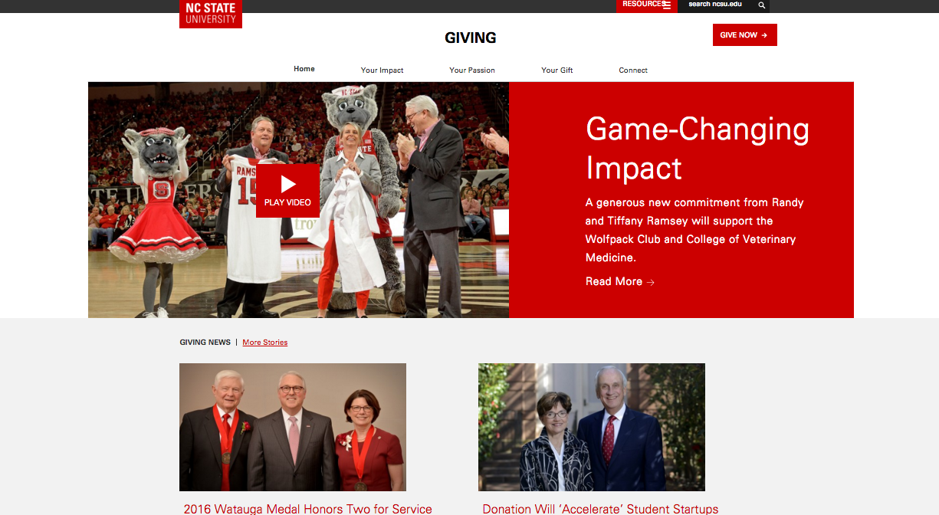
Campaign Communications Overview

Slide 21
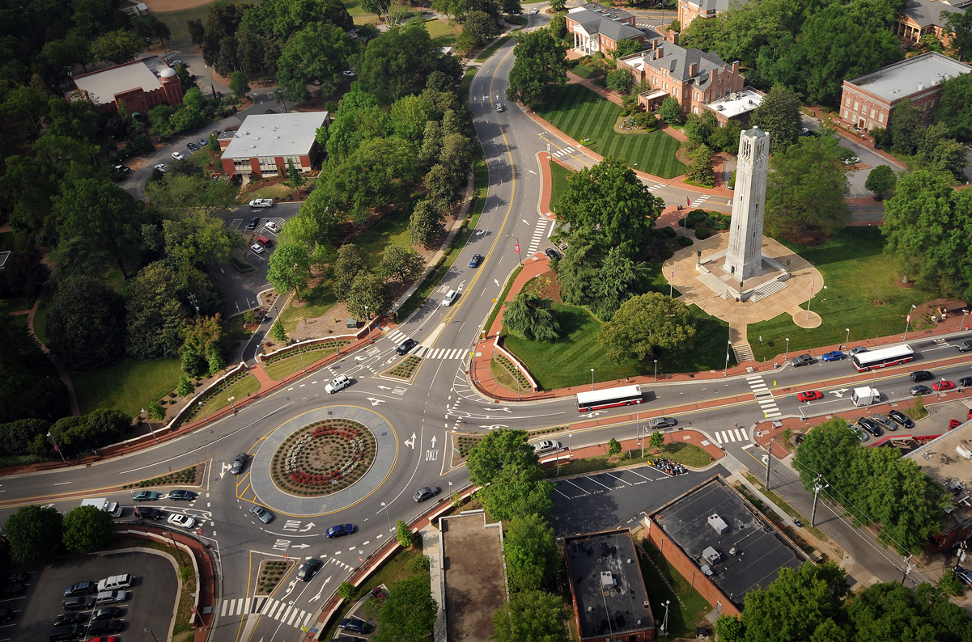
Built on a Strong Foundation
  Brand Implementation
  Campaign Preparedness Work
  Highlighting the “Power of Philanthropy”
  “Best Year Ever” in Fundraising

Slide 22
Sought Outside Expertise
  Lead a collaborative, consensus-building effort to recommend campaign identity, categories and key messages
  Test recommended identity, categories and key messages
  Conduct a development communications audit
  Work with Campaign Communications Leadership Team on creation of a Campaign Communications Plan

Slide 23
Already Completed
  Contracted with SimpsonScarborough to assist
  with Campaign Communications
  Three in-person and several virtual visits
    Meetings, forums and focus groups
  Online Focus Groups
  Qualitative Research
  Quantitate Research

Slide 24
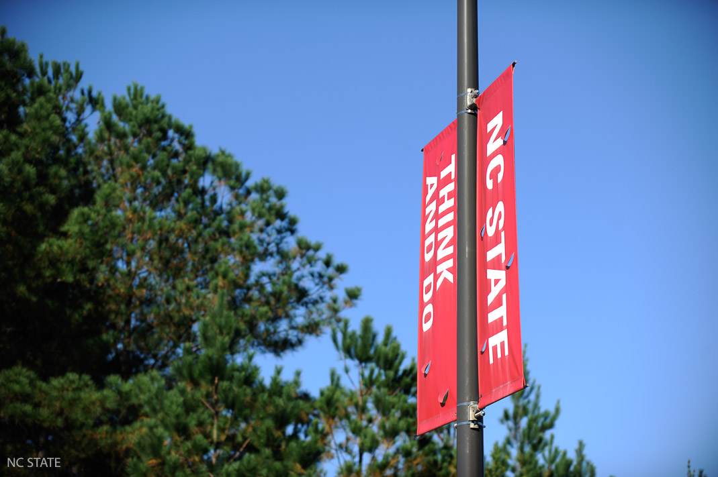
ALUMNI AND DONOR RESEARCH

Slide 25
Next Steps
  Mid-April – NC State provides final feedback on Campaign name, themes and messaging
  Late-April – SimpsonScarborough to present final Campaign name, messaging, research, etc.
  Mid-May – SimpsonScarborough delivers Campaign Communications Plan, Creative Concepts, Budget, Timeline and additional recommendations

Slide 26
Questions?

